Slide 1
HARDWARE PROJECT
FINGERPRINT SENSOR

Slide 2
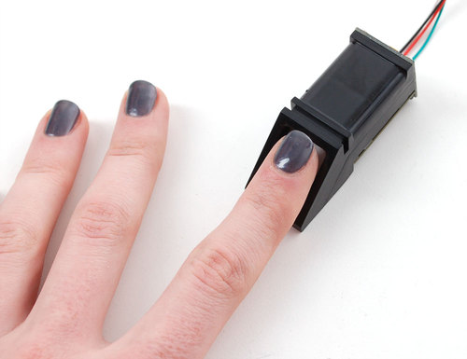
WHY A FINGERPRINT SENSOR?
The basic function of a fingerprint sensor is to get an image of a person’s fingerprint and find a match for this print in the database. You can use this sensor for various operations such as enrollment or as a security measure too. It only permits access to perform any action be it unlocking a phone or an app or any confidential information only if the fingerprint matches.
Advantages:
Convenience, you don’t need to memorize something.
Substitute for passwords and pin codes.
Fast Lock/unlock devices screen and applications.

Slide 3

SCHEDULE
https://github.com/RamyaRadhakrishnakumar/FingerPrintReader/blob/master/RamyaRadhakrishnakumar.mpp

Slide 4
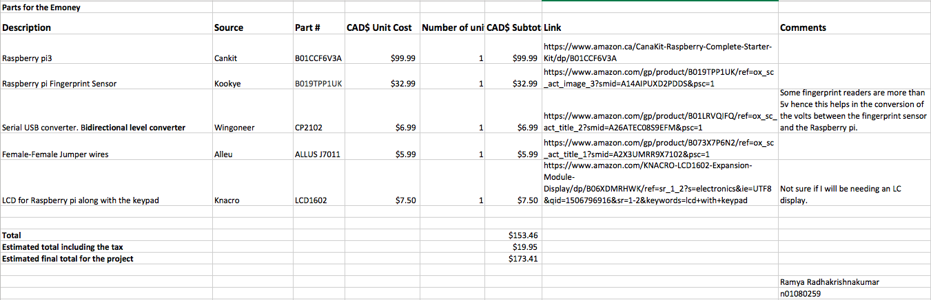
BUDGET
https://github.com/RamyaRadhakrishnakumar/FingerPrintReader/blob/master/hardwarebudget.xlsx

Slide 5
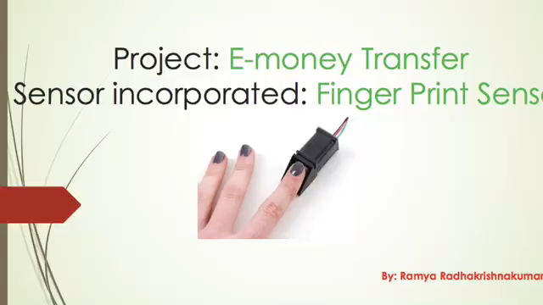
BUILT VIDEO/DEMONSTRATION
https://github.com/RamyaRadhakrishnakumar/FingerPrintReader/blob/master/My%20Movie.mp4

Slide 6
RESOURCES FROM PREVIOUS COURSES
TECH 101, 150 ELECTRIC/ELECTRONIC CIRCUITS
TECH 153 TECHNICAL C
TECH 216 SOFTWARE PROJECT
TECH 317 HARDWARE PRODUCTION TECHNOLOGY
Also Google, YouTube and Wikipedia.

Slide 7
THANK YOU FOR YOUR TIME ☺
Name: Ramya Radhakrishnakumar
Student no: n01080259

